Slide 1



GRADE 10 · ALGEBRA II · WEEK 7
Pre-Session
Home task before class
Lesson 2-4
Overview of Complex Numbers
Watch · Study · Check · Submit on the LMS before class
Lesson 2-5
Completing the Square
Mr Malek Thiab
FAITH, RIGHTEOUSNESS AND WISDOM
Notes:
Speaker notes: Send this pre-session to students before Week 7. It covers Lesson 2-4 Overview of Complex Numbers and Lesson 2-5 Completing the Square. Students work through six stations at home: watch a short video, study two worked examples, and answer three readiness questions, for each lesson. Their answers tell you where to start the in-class Diagnose.

Slide 2


Your home journey
Six stations before the lesson: watch, study the examples, check yourself, twice.
Examples
Lesson 2-4
Watch
Lesson 2-5
Check
Lesson 2-5
2
4
6
1
3
5
Watch
Lesson 2-4
Check
Lesson 2-4
Examples
Lesson 2-5
FAITH, RIGHTEOUSNESS AND WISDOM
Notes:
Speaker notes: Walk through the map with students: stations 1 to 3 prepare Lesson 2-4, stations 4 to 6 prepare Lesson 2-5. Each lesson: Watch (about 5 to 8 minutes), Examples, Check. In slideshow mode the Morph transition zooms the circles into the breadcrumb at the top of each later slide.

Slide 3
1
2
3
4
5
6
STATION 1 · WATCH · LESSON 2-4
Overview of Complex Numbers
WATCH BEFORE CLASS · 5:19
KEY IDEA
Introduction to i and imaginary numbers
Khan Academy · 5:19
Open on YouTube
LISTEN FOR
What number the imaginary unit i is defined to be, and what i squared equals.
How a square root of a negative number is rewritten using i.
How the powers of i repeat in a cycle, and the form a + bi for a complex number.
HSN.CN.A.1 · HSN.CN.A.2 · HSN.CN.A.3 · HSN.CN.C.8 · HSA.REI.B.4.B · HSN.CN.C.7 · HSA.SSE.B.3.B · HSA.REI.B.4.A · HSF.LE.B.6 · HSF.IF.C.8.A
FAITH, RIGHTEOUSNESS AND WISDOM
Mr Malek Thiab · 3
Notes:
Speaker notes (Lesson 2-4, Station 1, Watch and key idea):
Video: Introduction to i and imaginary numbers by Khan Academy, length 5:19, https://www.youtube.com/watch?v=ysVcAYo7UPI
Pause the video at the definition of i and again at the powers of i. Misconception to say aloud: i is not a variable and not nothing; it is a number whose square is -1. Warn that sqrt(-9) = 3i, NOT -3 and NOT 3. Also warn that sqrt(-4)*sqrt(-9) must be converted to 2i*3i = -6 first; combining under one root first gives the wrong sign.

Slide 4
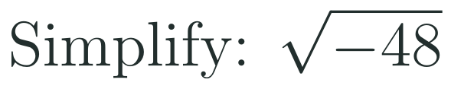
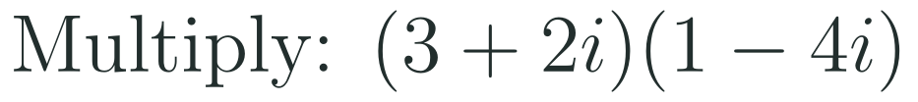
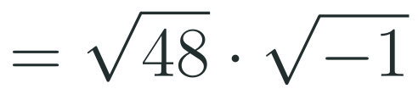

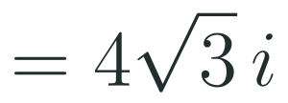


1
2
3
4
5
6
STATION 2 · EXAMPLES · LESSON 2-4
Study the worked examples
EXAMPLE A
1
EXAMPLE B
2
HSN.CN.A.1 · HSN.CN.A.2 · HSN.CN.A.3 · HSN.CN.C.8 · HSA.REI.B.4.B · HSN.CN.C.7 · HSA.SSE.B.3.B · HSA.REI.B.4.A · HSF.LE.B.6 · HSF.IF.C.8.A
FAITH, RIGHTEOUSNESS AND WISDOM
Mr Malek Thiab · 4
Notes:
Speaker notes (Lesson 2-4, Station 2, Worked examples):
Ex1: sqrt(-48) = sqrt(48)*i; 48 = 16*3 so sqrt(48) = 4*sqrt(3); answer 4*sqrt(3)*i (write i clearly outside the radical). Ex2: (3+2i)(1-4i) = 3 - 12i + 2i - 8i^2 = 3 - 10i + 8 = 11 - 10i. Misconception: students forget i^2 = -1 and leave -8i^2, or get -8 instead of +8. Addition is like combining like terms: real with real, imaginary with imaginary.

Slide 5
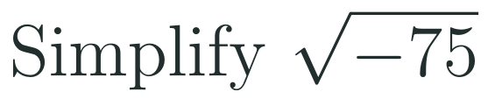

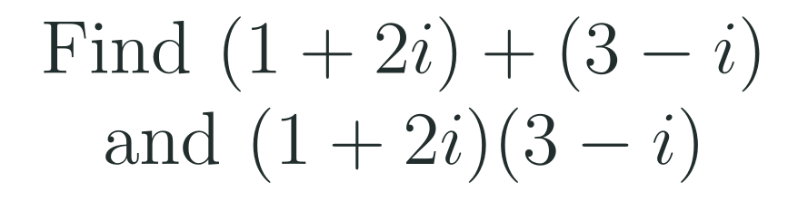
1
2
3
4
5
6
STATION 3 · CHECK · LESSON 2-4
Check yourself: three questions
1
2
3
Done when
you can write a square root of a negative number with i, use the cycle of four to find a power of i, and give sums and products in the form a + bi.
HSN.CN.A.1 · HSN.CN.A.2 · HSN.CN.A.3 · HSN.CN.C.8 · HSA.REI.B.4.B · HSN.CN.C.7 · HSA.SSE.B.3.B · HSA.REI.B.4.A · HSF.LE.B.6 · HSF.IF.C.8.A
FAITH, RIGHTEOUSNESS AND WISDOM
Mr Malek Thiab · 5
Notes:
Speaker notes (Lesson 2-4, Station 3, Readiness check):
Q1: sqrt(-75) = sqrt(25*3)*i = 5*sqrt(3)*i. Q2: 43 = 4*10 + 3, so i^43 = i^3 = -i. Q3: sum = 4 + i; product = 3 - i + 6i - 2i^2 = 3 + 5i + 2 = 5 + 5i. Routing: if most students miss Q1, spend the first 3 minutes of Diagnose on simplifying radicals such as sqrt(48) before adding i. If most miss Q2, redraw the cycle i, -1, -i, 1 and divide the exponent by 4, using the remainder. If most miss Q3, rehearse expanding (a+b)(c+d) and replacing i^2 by -1.

Slide 6

1
2
3
4
5
6
STATION 4 · WATCH · LESSON 2-5
Completing the Square
WATCH BEFORE CLASS · 6:14
KEY IDEA
Completing the Square | From Standard to Vertex Form
Brian McLogan · 6:14
Open on YouTube
LISTEN FOR
Why half of the coefficient of x is found and then squared.
How the expression stays equal after a number is added to it.
How the vertex and the minimum value can be read from the finished form.
HSN.CN.A.1 · HSN.CN.A.2 · HSN.CN.A.3 · HSN.CN.C.8 · HSA.REI.B.4.B · HSN.CN.C.7 · HSA.SSE.B.3.B · HSA.REI.B.4.A · HSF.LE.B.6 · HSF.IF.C.8.A
FAITH, RIGHTEOUSNESS AND WISDOM
Mr Malek Thiab · 6
Notes:
Speaker notes (Lesson 2-5, Station 4, Watch and key idea):
Video: Completing the Square | From Standard to Vertex Form by Brian McLogan, length 6:14, https://www.youtube.com/watch?v=L1Wnq-2vxWw
This pre-session covers only leading coefficient 1. Pause the video where (b/2)^2 is added and subtracted. Misconception to say aloud: you may not just add a number; in an equation add it to BOTH sides, in an expression add AND subtract it. Another: the sign inside the bracket matches the sign of b/2, but the vertex x-coordinate has the opposite sign (x - 4 gives h = 4).

Slide 7

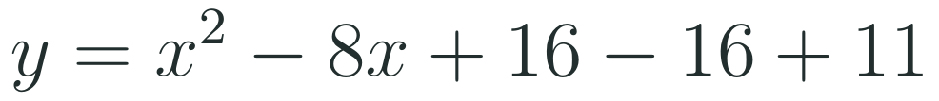

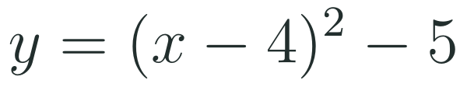
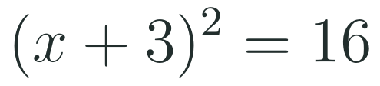
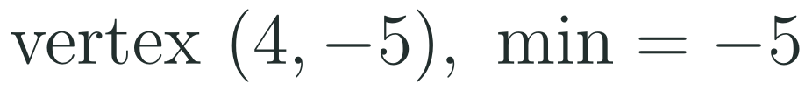
1
2
3
4
5
6
STATION 5 · EXAMPLES · LESSON 2-5
Study the worked examples
EXAMPLE A
1
EXAMPLE B
2
HSN.CN.A.1 · HSN.CN.A.2 · HSN.CN.A.3 · HSN.CN.C.8 · HSA.REI.B.4.B · HSN.CN.C.7 · HSA.SSE.B.3.B · HSA.REI.B.4.A · HSF.LE.B.6 · HSF.IF.C.8.A
FAITH, RIGHTEOUSNESS AND WISDOM
Mr Malek Thiab · 7
Notes:
Speaker notes (Lesson 2-5, Station 5, Worked examples):
Ex1: x^2 + 6x - 7 = 0 -> x^2 + 6x = 7; half of 6 is 3, 3^2 = 9; add 9 to both sides: x^2 + 6x + 9 = 16, so (x+3)^2 = 16 (check: x = 1 or x = -7 both satisfy the original). Ex2: y = x^2 - 8x + 11; half of -8 is -4, 16 added and subtracted: y = (x-4)^2 - 16 + 11 = (x-4)^2 - 5; vertex (4, -5); the square is never negative, so the minimum is -5 at x = 4. Misconception: forgetting to subtract the 16 again.

Slide 8
1
2
3
4
5
6
STATION 6 · CHECK · LESSON 2-5
Check yourself: three questions
1
2
3
Done when
you can add the square of half the coefficient of x to both sides of an equation, and write a quadratic with leading coefficient 1 in vertex form and name its minimum value.
HSN.CN.A.1 · HSN.CN.A.2 · HSN.CN.A.3 · HSN.CN.C.8 · HSA.REI.B.4.B · HSN.CN.C.7 · HSA.SSE.B.3.B · HSA.REI.B.4.A · HSF.LE.B.6 · HSF.IF.C.8.A
FAITH, RIGHTEOUSNESS AND WISDOM
Mr Malek Thiab · 8
Notes:
Speaker notes (Lesson 2-5, Station 6, Readiness check):
Q1: x^2 + 10x = 2; add 25: x^2 + 10x + 25 = 27, so (x+5)^2 = 27. Q2: y = x^2 - 6x + 9 - 9 + 5 = (x-3)^2 - 4. Q3: y = x^2 + 4x + 4 - 4 + 9 = (x+2)^2 + 5; minimum value 5 at x = -2. Routing: if most students miss Q1, spend the first 3 minutes of Diagnose on halving then squaring b, with negative values. If most miss Q2 or Q3, spend the time on add-and-subtract in an expression versus add-to-both-sides in an equation, and on reading h from the bracket sign.

Slide 9
Ready for class
Bring your answers and your questions.
Examples 2-4
Watch 2-5
Check 2-5
✓
✓
✓
✓
✓
✓
Watch 2-4
Check 2-4
Examples 2-5
Last time you solved quadratics and met the discriminant; this week a negative discriminant gets a number, and completing the square rewrites a quadratic so its minimum or maximum shows.
FAITH, RIGHTEOUSNESS AND WISDOM
Notes:
Speaker notes: Collect the submitted answers from the LMS before class and sort questions by how many students missed them. Start the in-class Diagnose on the least secure check question. Last time you solved quadratics and met the discriminant; this week a negative discriminant gets a number, and completing the square rewrites a quadratic so its minimum or maximum shows.

